Slide 1
AI Assignment 2
Satya - CS22B011
Raghuveer - CS22B019

Slide 2
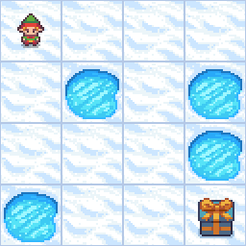
Branch and Bound :
Path Found: [0, 1, 2, 6, 10, 14, 15]
Steps: 7
Time Taken: ~0.0060 seconds
Heuristic: None
Branch and Bound is a brute-force, uninformed search algorithm that explores all paths while pruning suboptimal branches. Since no heuristic is used, it guarantees optimality but may explore unnecessary paths in larger grids.

Slide 3
Iterative Deepening A* (IDA*)
Path Found: [0, 4, 8, 9, 13, 14, 15]
Steps: 7
Time Taken: ~0.0050 seconds
Heuristic Used: Manhattan Distance
h(n)=|rowcurrent−rowgoal∣+∣colcurrent−colgoal|
IDA* combines the space efficiency of DFS with the optimality of A* by using a cost threshold and gradually increasing it. Thanks to the admissible and consistent Manhattan heuristic, it also finds the optimal path but more efficiently than uninformed search.

Slide 4
Hill climbing
Hill Climbing is a local search optimization algorithm. It starts with a random solution and iteratively makes small changes (neighboring solutions) to improve the outcome. If the new solution is better, it moves to that; otherwise, it stays.
Pros:
  Simple to implement.
  Fast convergence.
Cons:
  Can get stuck in local optima.
  No mechanism to explore worse solutions temporarily for better long-term outcomes.

Slide 5
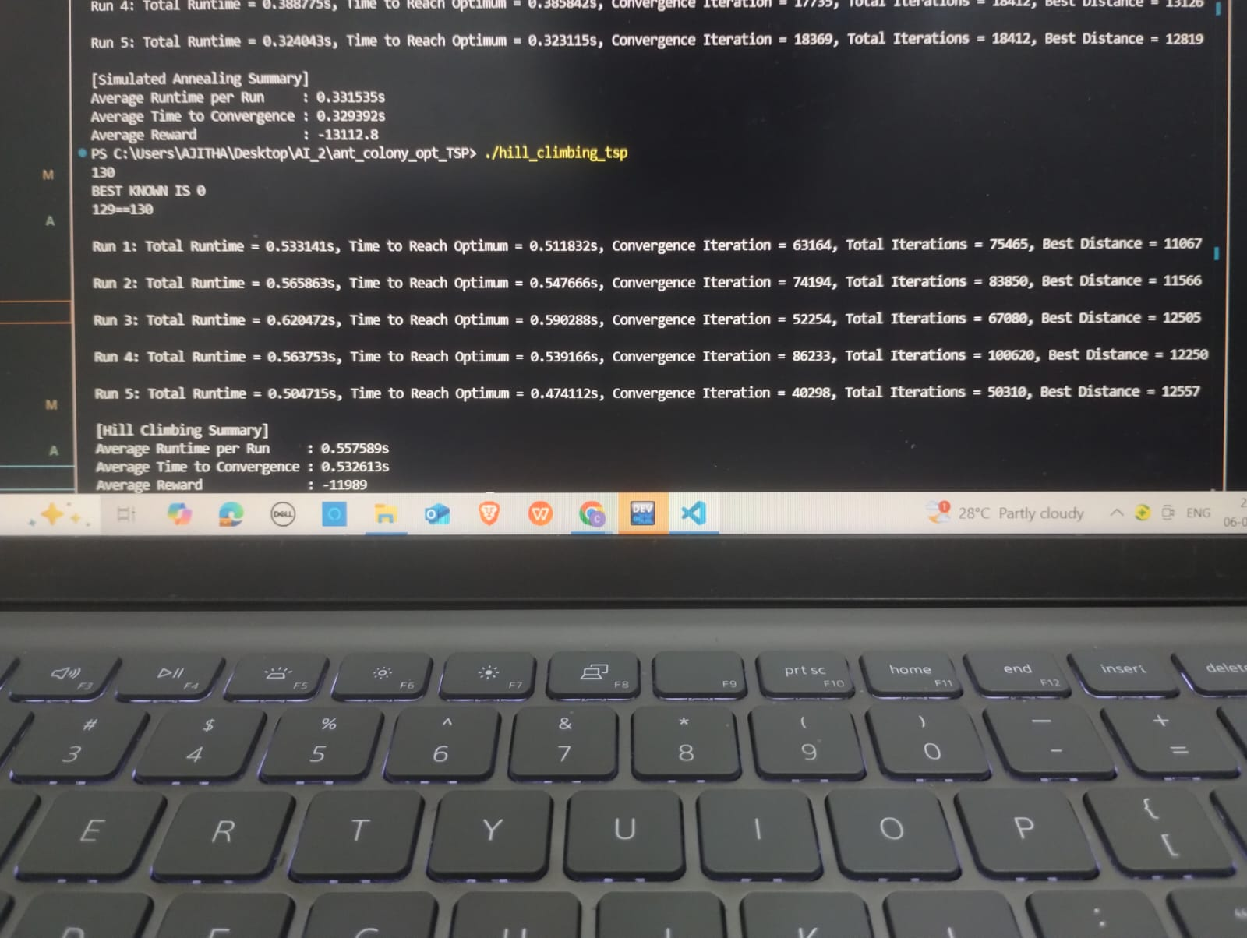
In this project, Hill Climbing is used to solve the Travelling Salesman Problem (TSP) by starting with a random tour (a sequence of cities). It repeatedly generates new solutions by swapping two cities in the tour. If the new solution results in a shorter total distance, it's accepted and becomes the new current solution.
The process continues for a fixed number of iterations or until no further improvement is found.
It's a greedy approach that only accepts better moves.
We recorded metrics like total runtime, convergence time, best distance, and number of iterations to analyze its performance.

Slide 6
Simulated annealing
Simulated Annealing is inspired by the annealing process in metallurgy. It allows probabilistic acceptance of worse solutions early on to escape local optima. The "temperature" controls this probability and gradually decreases during the search.
Pros:
  Escapes local optima.
  Suitable for large search spaces.
Cons:
  Requires tuning (initial temperature, cooling rate).
  Slower than Hill Climbing.

Slide 7
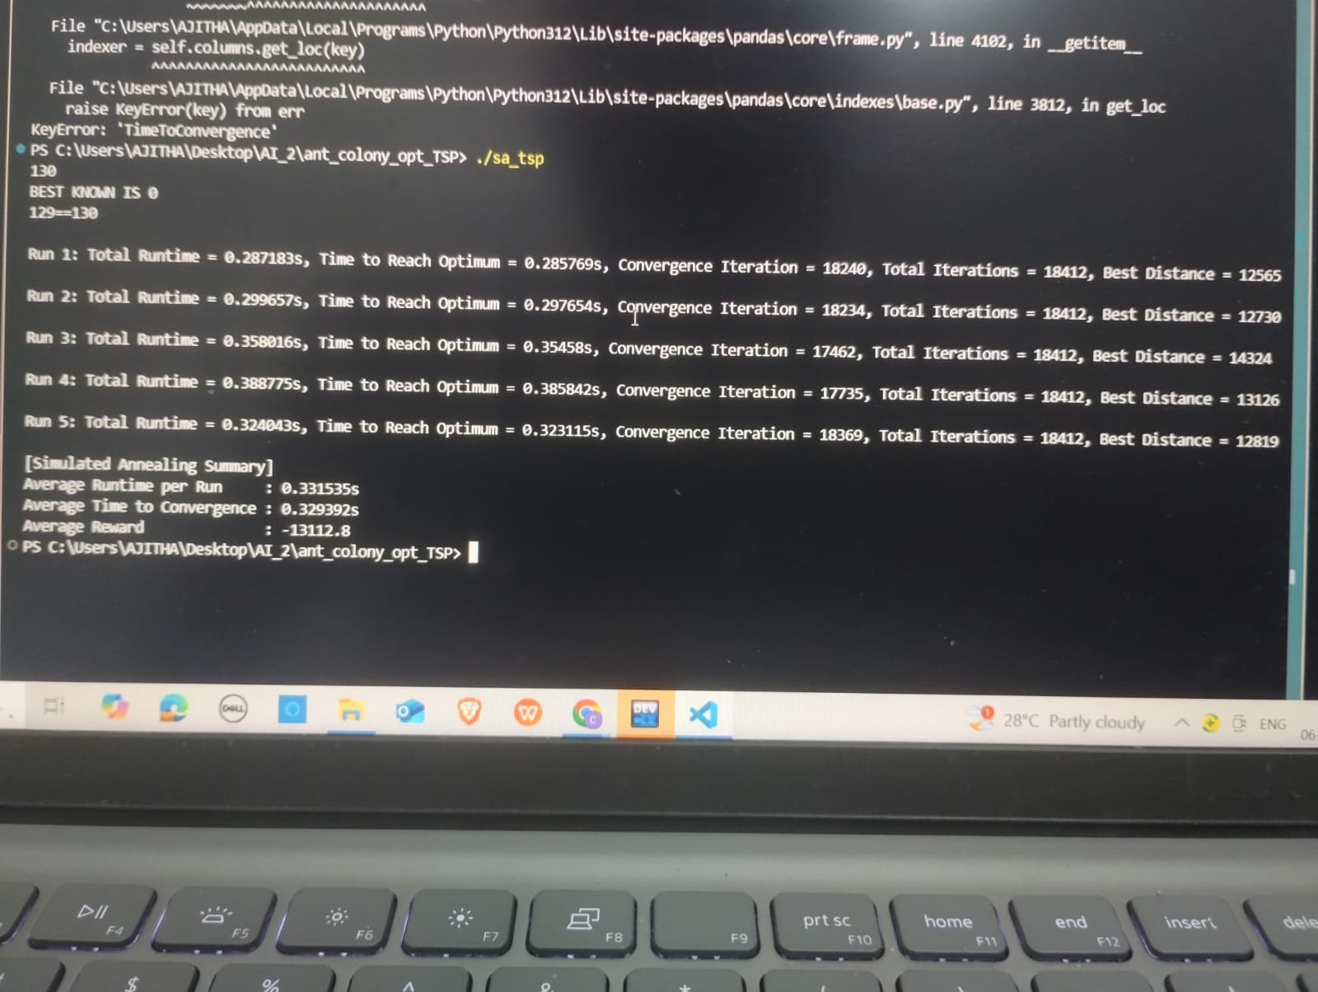
Simulated Annealing also starts with a random tour, but unlike Hill Climbing, it sometimes accepts worse solutions to avoid getting stuck in local optima. It uses a temperature value that controls the probability of accepting worse solutions.
At each step, a new tour is generated by swapping two cities.
If the new tour is better, it's accepted.
The temperature gradually decreases using a cooling schedule.
Just like with HC, we track convergence time, best distance, and generate visual frames to analyze the algorithm's behavior.

Slide 8
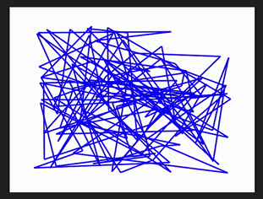
So as my GIF contains more than 80,000 frames so it is not possible to insert here hence i’ve added videos.
This is for simulated annealing

Slide 9
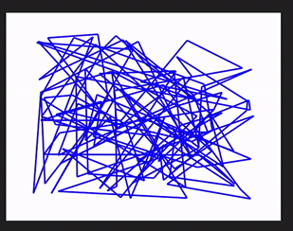
This is for hill climbing

